Slide 1
Chapter 17

Slide 2
Objectives

Slide 3
Objectives (cont.)

Slide 4
The Movie table

Slide 5
Concepts

Slide 6
The relationship between two tables

Slide 7
Concepts

Slide 8
The columns of the Category table

Slide 9
The columns of the Movie table

Slide 10
Common SQLite data types

Slide 11
The syntax for a SELECT statement that gets all columns

Slide 12
The syntax for a SELECT statement that gets selected columns

Slide 13
The syntax for a SELECT statement that joins two tables

Slide 14
The syntax for the INSERT statement

Slide 15
The syntax for the UPDATE statement

Slide 16
The syntax for the DELETE statement

Slide 17
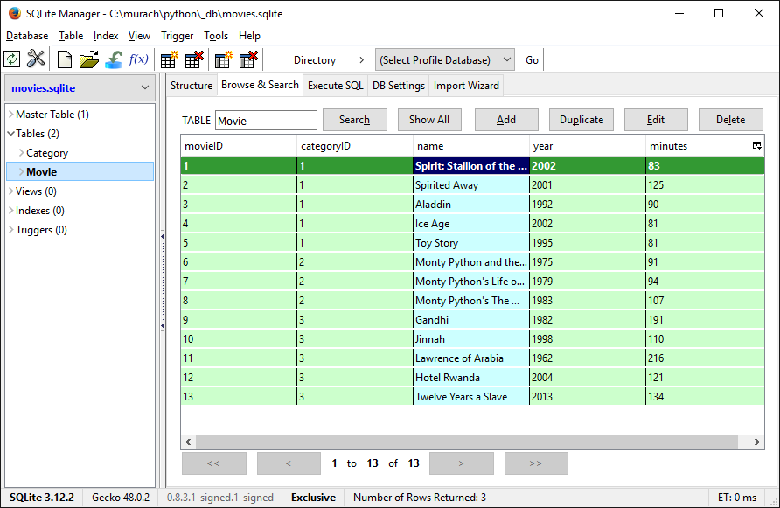
SQLite Manager’s Browse & Search tab

Slide 18
How to connect to a SQLite database and view a table

Slide 19
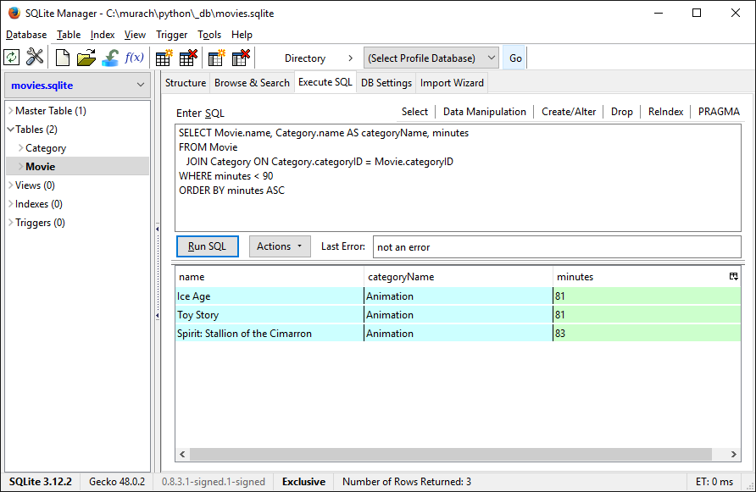
The Execute SQL tab

Slide 20
How to import the SQLite module

Slide 21
How to close a connection object

Slide 22
The cursor() method of the connection object

Slide 23
How to get a cursor from the connection object

Slide 24
How to automatically close the cursor object

Slide 25
The fetchone() and fetchall() methods of the cursor object

Slide 26
How to use the fetchone() method to get a row

Slide 27
How to access columns by index

Slide 28
How to use the fetchall() method to get all rows

Slide 29
The commit() method of the connection object

Slide 30
How to execute an INSERT statement

Slide 31
How to execute an UPDATE statement

Slide 32
How to execute a DELETE statement

Slide 33
Code that tests the database

Slide 34
Code that tests the database (cont.)

Slide 35
Code that tests the database (cont.)

Slide 36
The user interface for the Movie List program

Slide 37
The user interface (cont.)

Slide 38
The objects module for the business tier

Slide 39
The db module for the database tier

Slide 40
The db module for the database tier (cont.)

Slide 41
The db module for the database tier (cont.)

Slide 42
The db module for the database tier (cont.)

Slide 43
The db module for the database tier (cont.)

Slide 44
The ui module for the presentation tier

Slide 45
The ui module for the presentation tier (cont.)

Slide 46
The ui module for the presentation tier (cont.)

Slide 47
The ui module for the presentation tier (cont.)

Slide 48
The ui module for the presentation tier (cont.)

